Slide 1

CHAPTER 4
PUBLIC KEY CRYPTO
PREPARED BY:
DR. MUHAMMAD IQBAL HOSSAIN
ASSOCIATE PROFESSOR
DEPARTMENT OF CSE, BRAC UNIVERSITY

Slide 2
APPENDIX
MODULAR ARITHMETIC
KNAPSACK
RSA

Slide 3
MODULAR ARITHMETIC
For integer x and n, “x mod n” is the remainder of x / n.
Examples
  7 mod 6 = 1
  33 mod 5 = 3
  33 mod 6=3
  51 mod 17 = 0
  17 mod 6 = 5
  Practice
  6 mod 5 = ?
  23 mod 5 = ?
  10 mod 5 = ?
  58 mod 20 = ?
  100 mod 20 = ?
CHAPTER 3 SYMMETRIC KEY CRYPTO. DR. MUHAMMAD IQBAL HOSSAIN

Slide 4
MODULAR ADDITION
Notation and facts
  7 mod 6 = 1
  7 = 13 = 1 mod 6
  ((a mod n) + (b mod n)) mod n = (a + b) mod n
  ((a mod n)(b mod n)) mod n = ad mod n
Addition example
  3 + 5 = 2 mod 6
  2 + 4 = 0 mod 6
  3 + 3 = 0 mod 6
  (7 + 12) mod 6 = 19 mod 6 = 1 mod 6
  (7 + 12) mod 6 = (1 + 0) mod 6 = 1 mod 6
CHAPTER 3 SYMMETRIC KEY CRYPTO. DR. MUHAMMAD IQBAL HOSSAIN

Slide 5
MODULAR MULTIPLICATION
Multiplication example
  3 . 4 = 0 mod 6
  2 . 4 = 2 mod 6
  5 . 5 = 1 mod 6
  (7 . 4) mod 6 = 28 mod 6 = 4 mod 6
  (7 .4) mod 6 = (1 .4) mod 6 = 4 mod 6
CHAPTER 3 SYMMETRIC KEY CRYPTO. DR. MUHAMMAD IQBAL HOSSAIN

Slide 6
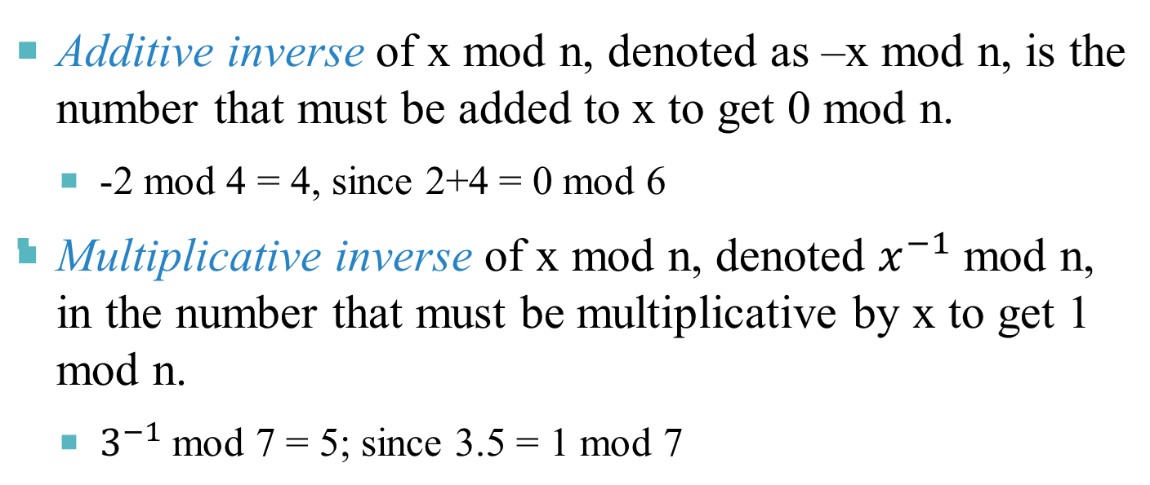
MODULAR INVERSE
6
-2 mod 4 = 6 since 2+4 = 0+6
CHAPTER 3 SYMMETRIC KEY CRYPTO. DR. MUHAMMAD IQBAL HOSSAIN

Slide 7
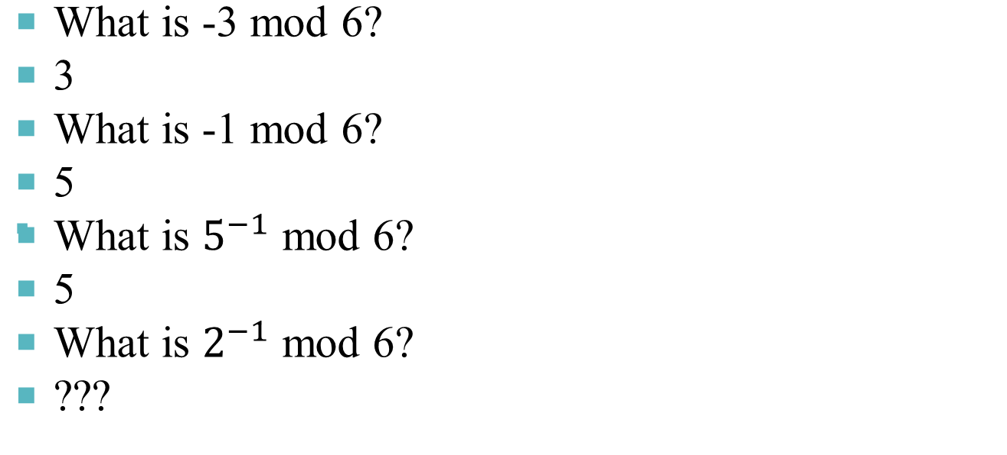
MODULAR ARITHMETIC QUIZ
CHAPTER 3 SYMMETRIC KEY CRYPTO. DR. MUHAMMAD IQBAL HOSSAIN

Slide 8
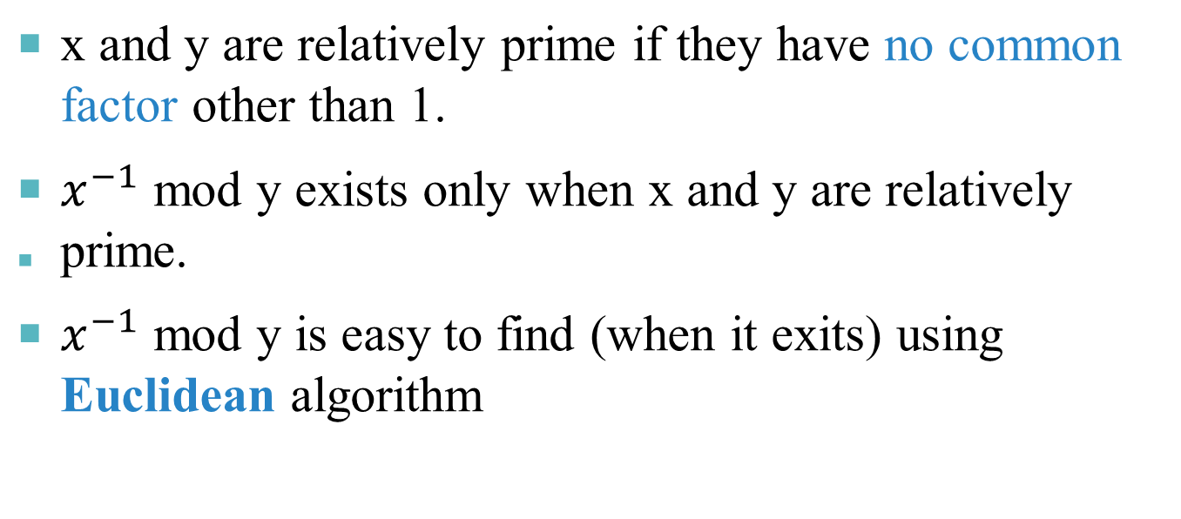
RELATIVE PRIMALITY
CHAPTER 3 SYMMETRIC KEY CRYPTO. DR. MUHAMMAD IQBAL HOSSAIN

Slide 9
TOTIENT FUNCTION
ϕ(n) in the number of numbers less than n that are relatively prime to n.
  Positive integer.
Example
  ϕ(4) = 2 since 4 is relatively prime to 3, 1.
  ϕ(5) = 4 since 5 is relatively prime to 1, 2, 3, 4
  ϕ(12) = 4
  ϕ(p) = p-1 if p in prime.
  ϕ(pq) = (p-1)(q-1) if p and q prime
CHAPTER 3 SYMMETRIC KEY CRYPTO. DR. MUHAMMAD IQBAL HOSSAIN

Slide 10
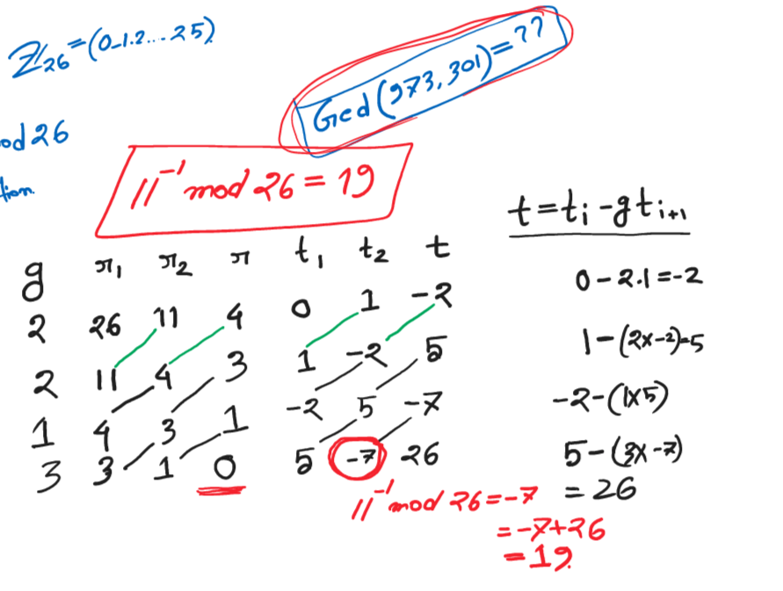
CHAPTER 3 SYMMETRIC KEY CRYPTO. DR. MUHAMMAD IQBAL HOSSAIN

Slide 11
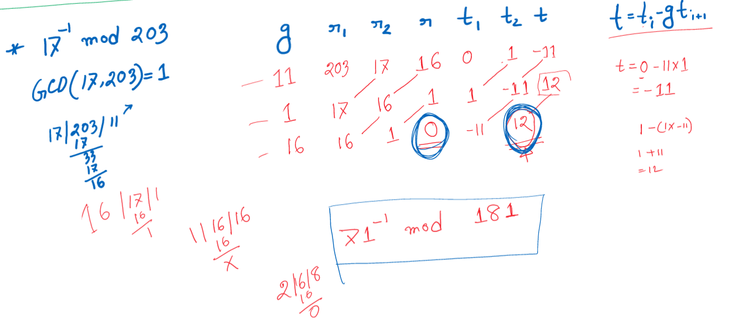
CHAPTER 3 SYMMETRIC KEY CRYPTO. DR. MUHAMMAD IQBAL HOSSAIN

Slide 12
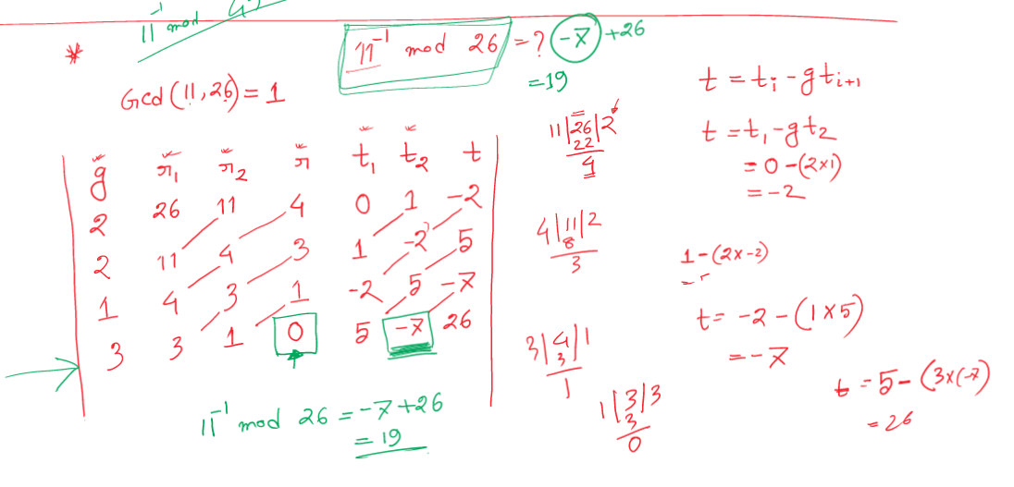
CHAPTER 3 SYMMETRIC KEY CRYPTO. DR. MUHAMMAD IQBAL HOSSAIN

Slide 13
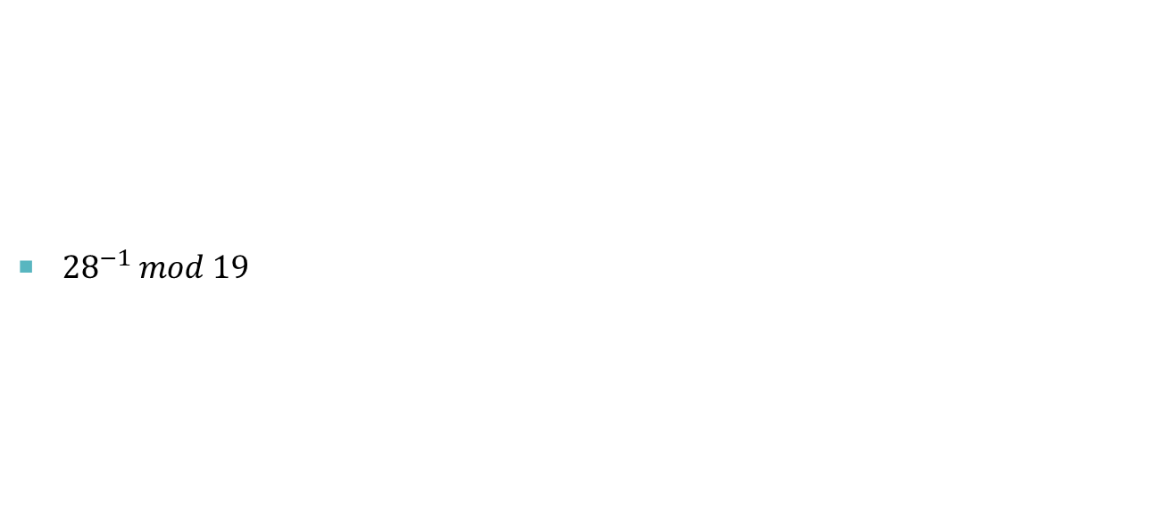
CHAPTER 3 SYMMETRIC KEY CRYPTO. DR. MUHAMMAD IQBAL HOSSAIN

Slide 14
PKC IS NEWCOMER
Different name
  Asymmetric cryptography
    Consider the symmetric cryptography
  Two key cryptography
  Non-security key cryptography
The concept is relative newcomer
  In the late 1960s by GCHQ of British
  Independently, in early 1970s by academic researchers
CHAPTER 3 SYMMETRIC KEY CRYPTO. DR. MUHAMMAD IQBAL HOSSAIN
Notes:
Symmetric key is having 2 same key and share among two.
So it needs to be protected for two.
How about I have only one to myself?

Slide 15
MISCONCEPTIONS ON PKC
PKC is more secure than that of symm cipher
  Cipher Security is depends on computational work to break a cipher – both are depends on it
PKC made symm cipher obsolete
  The problem of computation overhead of PKC
Key distribution of PKC is trivial
  The procedures of PKC are so not simpler and more efficient than those of symm cipher
  PKI is required for the key distribution of PKC
CHAPTER 3 SYMMETRIC KEY CRYPTO. DR. MUHAMMAD IQBAL HOSSAIN

Slide 16
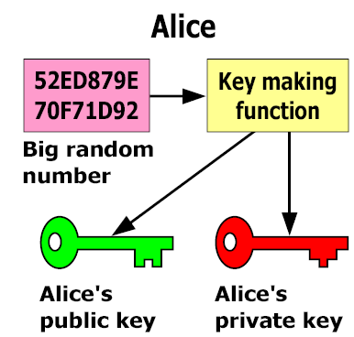
KEY GENERATION OF PKC
Making two keys: Based on trap door one way function
  Easy to compute in one direction
  Hard to compute in other direction
  “Trap door” used to create keys
  Example: Given p and q, product N=pq is easy to compute, but given N, it is hard to find p and q
A message encrypted by the public key can decrypted only with the corresponding private key
CHAPTER 3 SYMMETRIC KEY CRYPTO. DR. MUHAMMAD IQBAL HOSSAIN
Notes:
Trap door: difficult to divide a big number and find the prime factor.

Slide 17
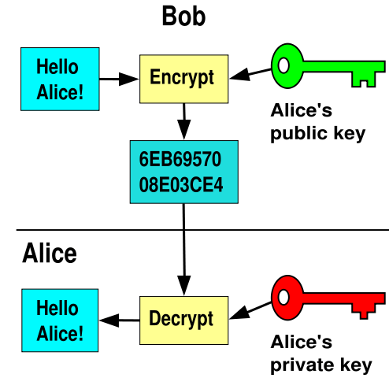
TWO MAIN BRACHES OF PKC
Public key Encryption
  Suppose we encrypt M with Alice’s public key
  Only Alice’s private key can decrypt to find M
CHAPTER 3 SYMMETRIC KEY CRYPTO. DR. MUHAMMAD IQBAL HOSSAIN

Slide 18
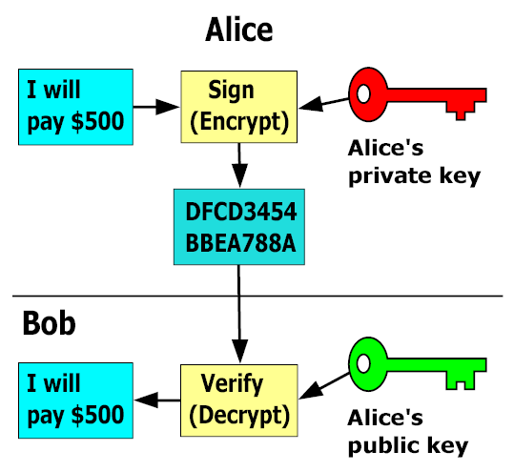
TWO MAIN BRANCHES OF PKC
Digital Signature
  Sign by “encrypting” with private key
  Anyone can verify signature by “decrypting” with public key
  But only private key holder could have signed
  Like a handwritten signature (and then some)
CHAPTER 3 SYMMETRIC KEY CRYPTO. DR. MUHAMMAD IQBAL HOSSAIN

Slide 19
PKCS TO DISCUSS
Knanpsack
  The first proposed PKC
  It is inscure
RSA
  Problem of factoring large numbers
Diffie-Hellman Key Exchange
  Discrete log problem
ECC(Elliptic Curve Cryptography)
  Based on the algebraic structure of elliptic curves over finite fields
CHAPTER 3 SYMMETRIC KEY CRYPTO. DR. MUHAMMAD IQBAL HOSSAIN

Slide 20

KNAPSACK
CHAPTER 3 SYMMETRIC KEY CRYPTO. DR. MUHAMMAD IQBAL HOSSAIN

Slide 21



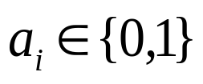

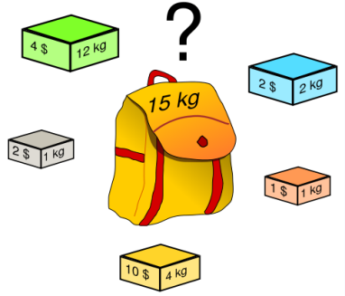
KNAPSACK PROBLEM
Given a set of weights and a sum , is it possible to find so that
(technically, this is “subset sum” problem)
Example
  Weights (62,93,26,52,166,48,91,141)
  Problem: Find subset that sums to S=302
  Answer: 62+26+166+48=302
The (general) knapsack is NP-complete
CHAPTER 3 SYMMETRIC KEY CRYPTO. DR. MUHAMMAD IQBAL HOSSAIN
Notes:
All PKC is Hard mathematical problem.
How to find? Brute fource?
2^8 search
What about 100 weight?
NP-complete: veeery hard
Make an attacker to solve NP complete problem

Slide 22
KNAPSACK PROBLEM
General knapsack (GK) is hard to solve
But superincreasing knapsack (SIK) is easy
SIK each weight greater than the sum of all previous weights
Example
  Weights (2,3,7,14,30,57,120,251)
  Problem: Find subset that sums to S=186
  Work from largest to smallest weight
  Answer: 120+57+7+2=186
CHAPTER 3 SYMMETRIC KEY CRYPTO. DR. MUHAMMAD IQBAL HOSSAIN

Slide 23
KNAPSACK CRYPTOSYSTEM
Generate superincreasing knapsack (SIK)
Convert SIK into “general” knapsack (GK)
  Public Key: GK
  Private Key: SIK plus conversion factors
Easy to encrypt with GK
With private key, easy to decrypt (convert ciphertext to SIK)
Without private key, must solve GK (???)
CHAPTER 3 SYMMETRIC KEY CRYPTO. DR. MUHAMMAD IQBAL HOSSAIN

Slide 24
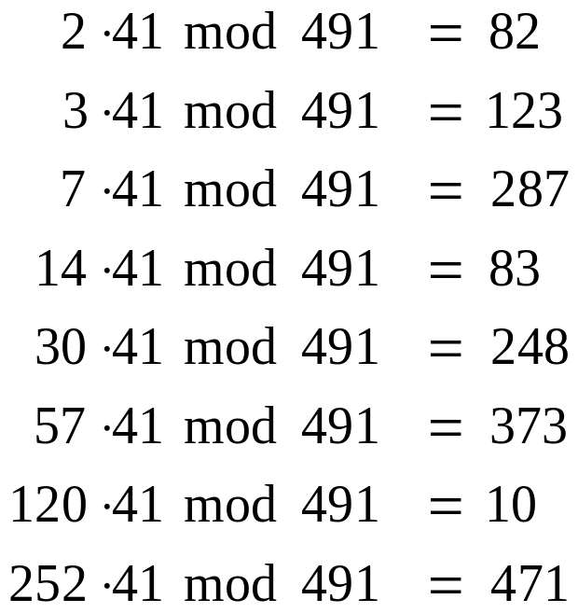
KNAPSACK CRYPTOSYSTEM
1. Let (2,3,7,14,30,57,120,251) be the SIK
2. Choose m = 41 and n = 491 with m, n rel. prime and n greater than sum of elements of SIK
Then General knapsack can be computed;
3. General knapsack: (82,123,287,83,248,373,10,471)
CHAPTER 3 SYMMETRIC KEY CRYPTO. DR. MUHAMMAD IQBAL HOSSAIN

Slide 25
KNAPSACK EXAMPLE
Private key: (2,3,7,14,30,57,120,251)
Public key: (82,123,287,83,248,373,10,471)
Example: Encrypt 10010110
  82 + 83 + 373 + 10 = 548
To decrypt
  548 · 12 = 193 mod 491 = S
  Solve (easy) SIK with S = 193
  193=2+14+57+120
  Obtain plaintext 10010110
CHAPTER 3 SYMMETRIC KEY CRYPTO. DR. MUHAMMAD IQBAL HOSSAIN

Slide 26
KNAPSACK WEAKNESS
Trapdoor: Convert SIK into “general” knapsack using modular arithmetic
One-way: General knapsack easy to encrypt, hard to solve; SIK easy to solve
This knapsack cryptosystem is insecure
  Broken in 1983 with Apple II computer
  The attack uses lattice reduction
  “General knapsack” derived from SIK is not general enough!
  This special knapsack is easy to solve!
CHAPTER 3 SYMMETRIC KEY CRYPTO. DR. MUHAMMAD IQBAL HOSSAIN

Slide 27
CHAPTER 3 SYMMETRIC KEY CRYPTO. DR. MUHAMMAD IQBAL HOSSAIN

Slide 28
RSA
Invented by Cocks (GCHQ), independently, by Rivest, Shamir and Adleman (MIT)
Let p and q be two large prime numbers
Let N = pq be the modulus
Choose e relatively prime to (p-1)(q-1)
Find d s.t. ed = 1 mod (p-1)(q-1)
Public key is (N,e)
Private key is d
CHAPTER 3 SYMMETRIC KEY CRYPTO. DR. MUHAMMAD IQBAL HOSSAIN

Slide 29


RSA
To encrypt message M compute
To decrypt C compute
Recall that e and N are public
If attacker can factor N, he can use e to easily find d since ed = 1 mod (p−1)(q−1)
Factoring the modulus breaks RSA
It is not known whether factoring is the only way to break RSA
CHAPTER 3 SYMMETRIC KEY CRYPTO. DR. MUHAMMAD IQBAL HOSSAIN

Slide 30
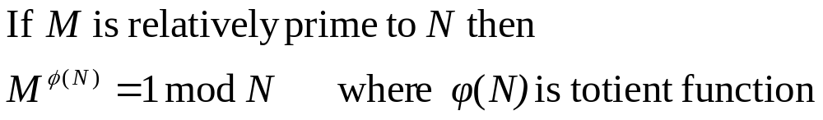


DOES RSA REALLY WORK?
Given , we must show
Euler’s Theorem
Facts:
  By definition of “mod”,
CHAPTER 3 SYMMETRIC KEY CRYPTO. DR. MUHAMMAD IQBAL HOSSAIN

Slide 31


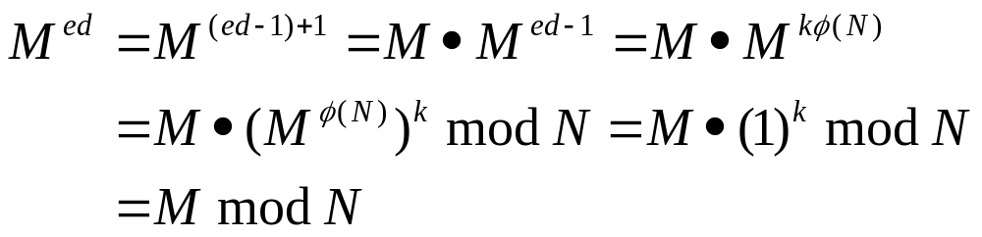
DOES RSA REALLY WORK?
Facts:
  By definition of “mod”,
  Then
Prove
CHAPTER 3 SYMMETRIC KEY CRYPTO. DR. MUHAMMAD IQBAL HOSSAIN

Slide 32
SIMPLE RSA EXAMPLE
Example of RSA
  Select “large” primes p = 11, q = 3
  Then N = pq = 33 and (p−1)(q−1) = 20
  Choose e = 3 (relatively prime to 20)
  Find d such that ed = 1 mod 20, we find that d = 7 works
Public key: (N, e) = (33, 3)
Private key: d = 7
CHAPTER 3 SYMMETRIC KEY CRYPTO. DR. MUHAMMAD IQBAL HOSSAIN

Slide 33
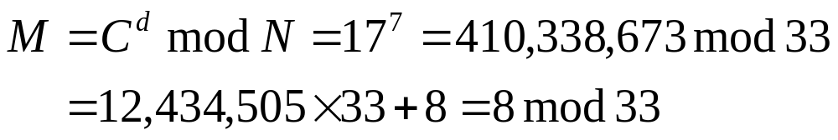
SIMPLE RSA EXAMPLE
Public key: (N, e) = (33, 3)
Private key: d = 7
Suppose message M = 8
Ciphertext C is computed as
Decrypt C to recover the message M by
CHAPTER 3 SYMMETRIC KEY CRYPTO. DR. MUHAMMAD IQBAL HOSSAIN

Slide 34
MORE EFFICIENT RSA (1)
Modular exponentiation example
  5²⁰ = 95367431640625 = 25 mod 35
A better way: repeated squaring
  20 = 10100 base 2
  (1, 10, 101, 1010, 10100) = (1, 2, 5, 10, 20)
  Note that 2 = 1⋅ 2, 5 = 2 ⋅ 2 + 1, 10 = 2 ⋅ 5, 20 = 2 ⋅ 10
  5¹= 5 mod 35
  5²= (5¹)² = 5² = 25 mod 35
  5⁵= (5²)² ⋅ 5¹ = 25² ⋅ 5 = 3125 = 10 mod 35
  5¹⁰ = (5⁵)² = 10² = 100 = 30 mod 35
  5²⁰ = (5¹⁰)² = 30² = 900 = 25 mod 35
Never have to deal with huge numbers!
CHAPTER 3 SYMMETRIC KEY CRYPTO. DR. MUHAMMAD IQBAL HOSSAIN

Slide 35
MORE EFFICIENT RSA (2)
Let e = 3 for all users (but not same N or d)
  Public key operations only require 2 multiplies
  Private key operations remain “expensive”
  If M < N^{1/3} then C = Me = M³ and cube root attack
    (mod N) operation has no effect
  For any M, if C₁, C₂, C₃ sent to 3 users, cube root attack works (uses Chinese Remainder Theorem)
  Can prevent cube root attack by padding message with random bits
Note: e = 2¹⁶ + 1 also used: Protect CRT attack
CHAPTER 3 SYMMETRIC KEY CRYPTO. DR. MUHAMMAD IQBAL HOSSAIN

Slide 36
end
CHAPTER 3 SYMMETRIC KEY CRYPTO. DR. MUHAMMAD IQBAL HOSSAIN

